Slide 1
Final Project: Audience Evaluation of Presentations
Group 5
Andrews Kontoh, Chaobo Cai, Yang Li, Olivia Ridge, Thomas Ghebremariam
Notes:
Hey guys, we are Group 5. Me along with ((other 4 names)) would like to introduce you to our final project, a website for audience evaluation of presentations.

Slide 2
Overview
An authenticated website that’s able to create presentation events by instructors/TAs.
Audience members will submit scores and comments as an evaluation form for each presentation.
Grades will be assigned by the instructor based on result of evaluation form.
Notes:
Here’s an overview of our project. It’s an authenticated website where instructors and TAs are able to create presentation events. After that, audience members, the students, would be able to do an evaluation form for the presentation of other groups. The website would then be able to generate a page summarizing the results of evaluation for instructor reference to assign grades.

Slide 3
Design process
Large idea
Creste model
view
More feature and adjustments
1
2
3
4
5
6
7
8
Database details
controller
Format and styling
ready

Slide 4
GOAL
For students
Give timely feedback on how they did on the project
Learn from each other and help each group improve
For instructor
Get an idea of how student think about performance of other groups
Easier to give feedback and grade

Slide 5
Users
Instructor/TA
Create, Read, Update, Delete presentation events
View summary score for each group
Students
Evaluate presentation of other groups
Check score of the group they are in

Slide 6
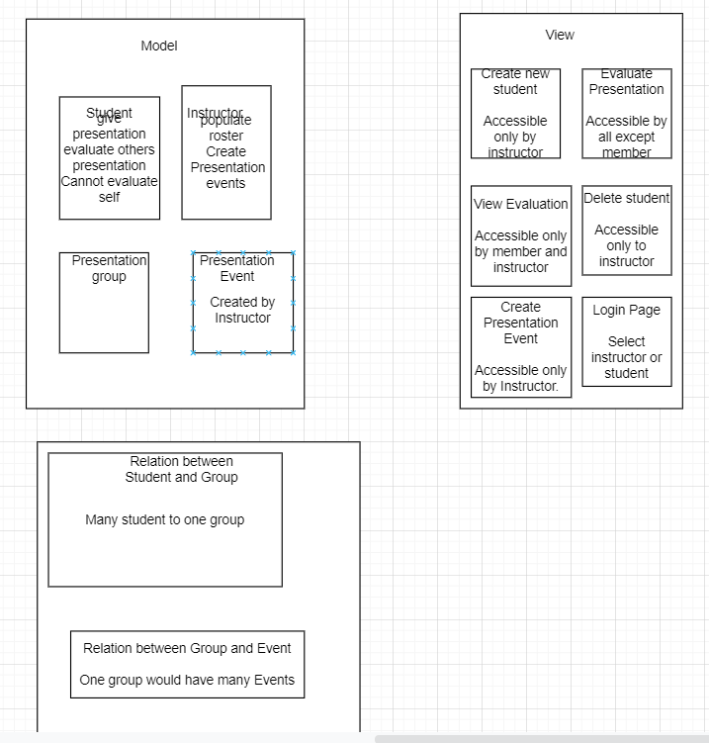
Models
Students
Instructors/TAs
Teams
Presentation Events
Related Evaluation
(Weak entity)

Slide 7
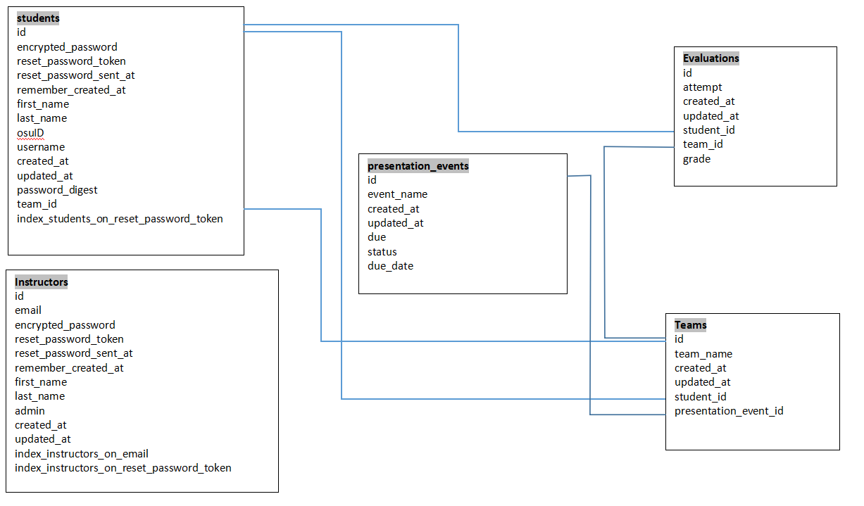
Database Schema-Design

Slide 8
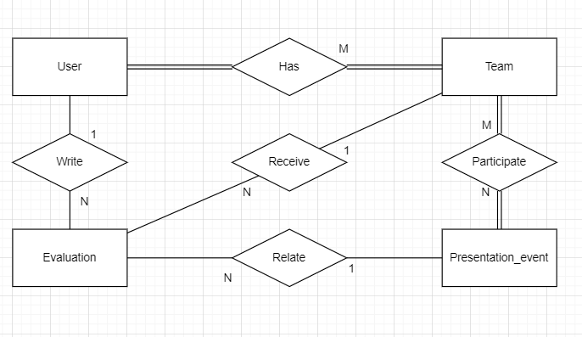
Architecture

Slide 9
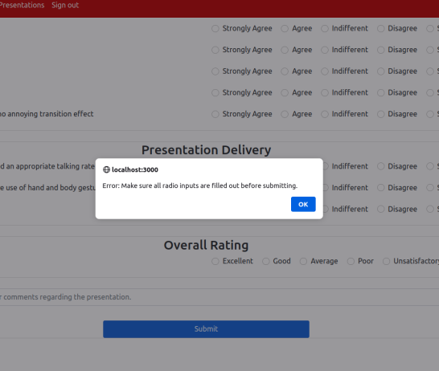
Additional Features & Packages
Javascript popup warning box
Bootstrap to make page more professional
Cocoon to create nested form
Potential:
Csv (for output)

Slide 10
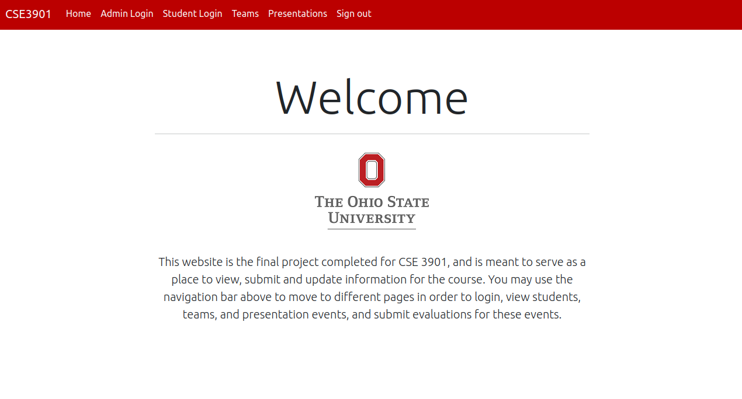
Client-View Demo Time

Slide 11
Challenges
Cocoon gem makes it difficult for us to assign students -> teams (create duplicates)
Difficult to integrate evaluations
Research problems (always encounter errors)

Slide 12
Final Goal
Prevent self-evaluation.
Auto-assign students -> teams
Monitor the submission of evaluations and have the statistics regarding submission
Have different output formats
(Maybe) deploy the application to a service such as Heroku

Slide 13
Thanks!
Any questions?

